Slide 1






PRESENTATION 2026
Student Feedback & Teaching Improvement Analyzer
Guide Name
Uma Maheshwari
Faculty Email
Faculty Name
4thjunetriveni@gmail.com
TRIVENI S. MASTI

Slide 2

Outline
Abstract of the Project
Problem Statement
Live Demo of Project
Faculty Performance Analysis
Issue Category Distribution
Course Recommendation Analysis
Proposed Solution
Conclusion: Key Insights & Findings
Future Scope

Slide 3

Problem Statement
Lack of Multilingual Feedback Processing
Lack of Standardized Metrics
The existing system does not support feedback submitted in regional or native languages, leading to the exclusion of a significant portion of student responses. This results in a representation bias and limits the inclusivity and comprehensiveness of the analysis.
No uniform framework for faculty evaluation makes comparative analysis difficult and subjective judgments more likely.
Lack of Personalized Faculty Improvement Roadmaps
Absence of Longitudinal Performance Tracking
The system identifies strengths and weaknesses but lacks personalized recommendations and development plans, limiting its effectiveness in improving teaching quality..
The current design lacks long-term tracking of faculty performance across semesters, making it difficult to identify trends, improvements, or declines and limiting effective academic planning.
No Continuous Tracking
Missing Real-Time Intervention
Faculty performance isn't monitored over time, preventing longitudinal improvement measurement and personalized development plans.
Without immediate feedback loops, opportunities for timely course correction and student support are lost during the semester.

Slide 4
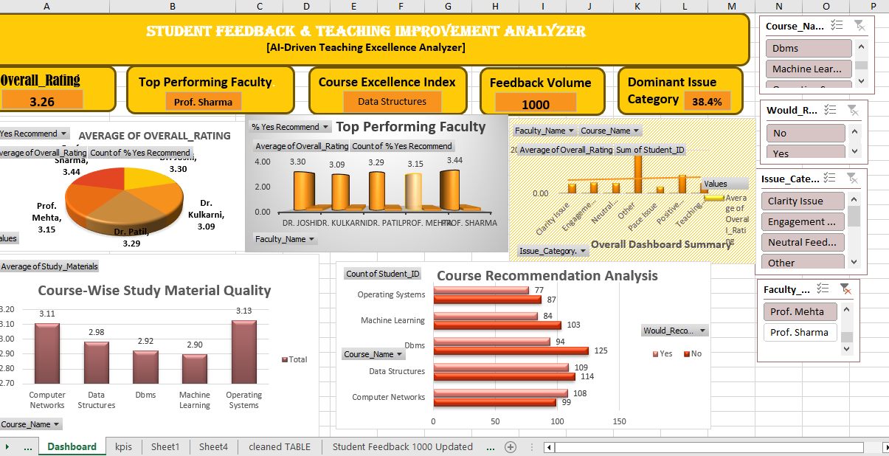
Live Demo of Project
Dashboard Snapshot
3.26
Average Faculty Rating:
Mean score across all courses and faculty
Total Feedback Responses: 1000
Total student responses analyzed
Top Faculty- Prof. Sharma
Clarity Issues Reported: 38.4%

Slide 5
Faculty Performance Analysis
Comparative analysis reveals performance variations across teaching staff, enabling targeted professional development and recognition of excellence. The visualization identifies top performers while highlighting faculty requiring additional support or training resources.

Slide 6
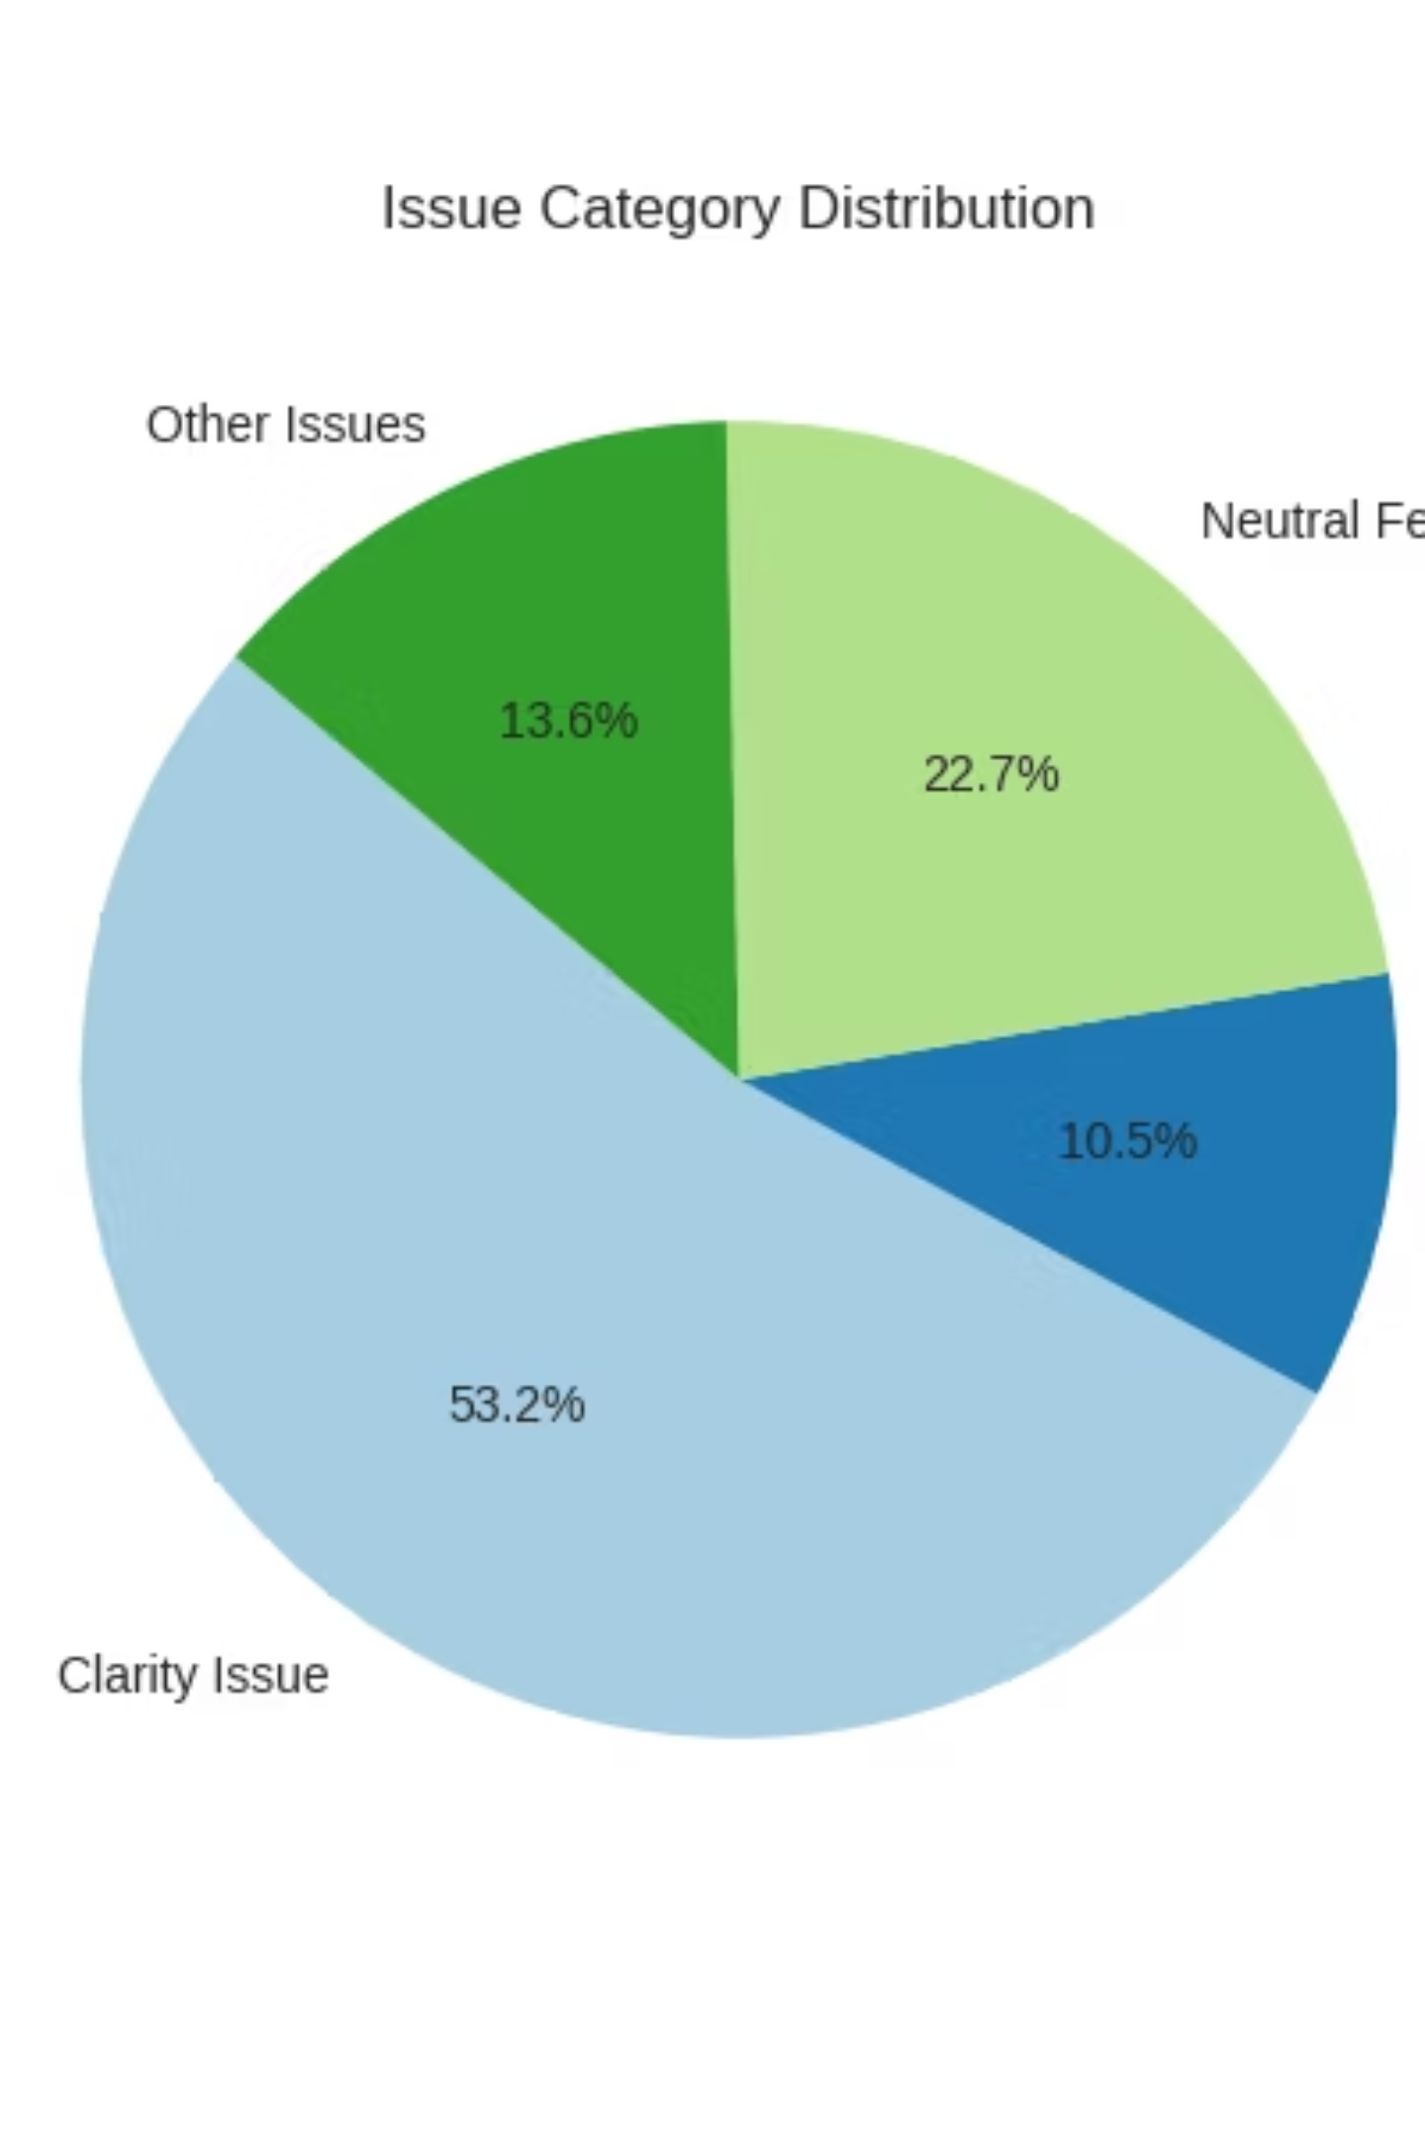
Issue Category Distribution
"Primary Issue Reported: Clarity (38.4%)"
"Secondary Issues:
Engagement, pacing,
and assessment methods"
Students most frequently report difficulty understanding course material and explanations.
Engagement, pacing, and assessment methods represent additional improvement opportunities.

Slide 7
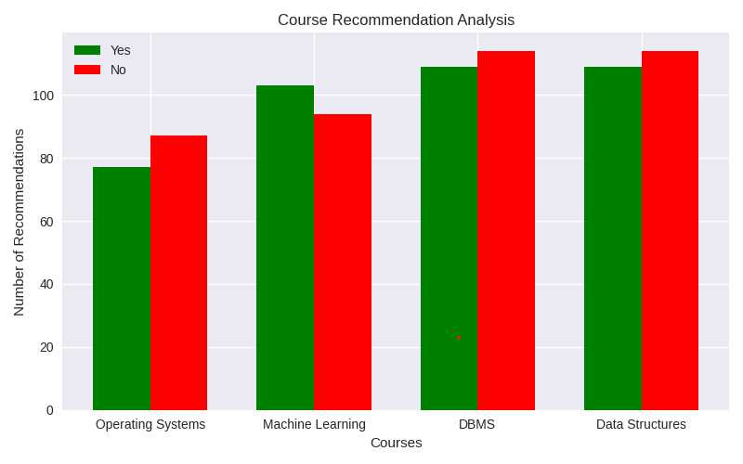
Course Recommendation Analysis
Strongest Recommendation: Data Structures
Mixed Satisfaction: Other courses need improvement

Slide 8

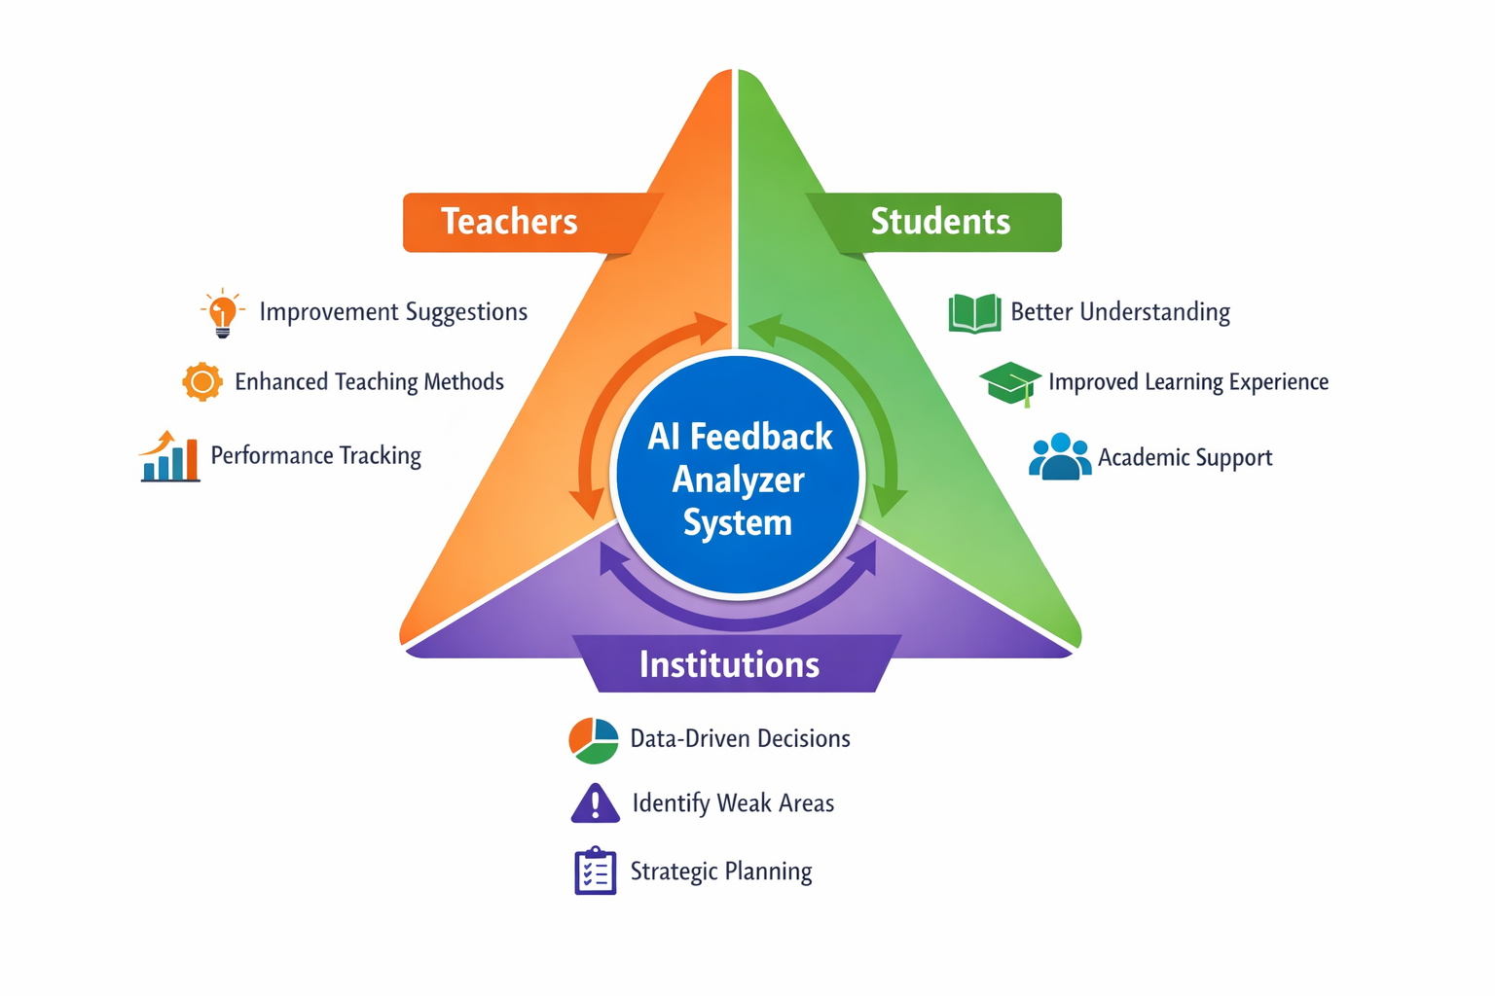
Proposed Solution
Conclusion: Key Benefits

Slide 9




Conclusion: Key Insights & Findings
Excellence Recognition
Communication Priority
Prof. Sharma demonstrates outstanding teaching performance, setting benchmark for faculty development programs.
Clarity issues dominate feedback, requiring focused faculty training on explanation techniques and accessibility.
CONCLUSION
Course Model
Improvement Opportunity
Data Structures course represents best practice example for curriculum design and instructional delivery.
Mixed course recommendations signal need for systematic quality enhancement initiatives.

Slide 10
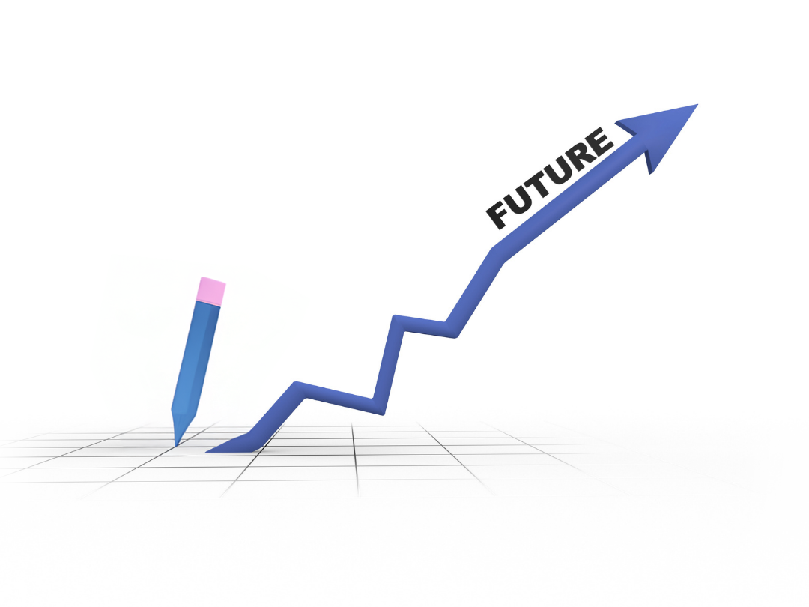

Future Scope
Expand feedback analysis to regional languages, ensuring inclusive access for diverse student populations.
Longitudinal Performance Tracking
Monitor faculty development across semesters to measure improvement and identify persistent challenges.
Personalized Improvement Plans
Real-Time Feedback Systems
Generate customized professional development recommendations based on individual performance data.
Enable mid-semester interventions through continuous feedback collection and immediate alerts.

Slide 11
Thank You
AICW Fellowship | Student Project Presentation 2026
LinkedIn | Edunet Foundation

